Slide 1
Modelling Crystallisation of Norilsk Parent Magma Candidates
Morgan Williams
Notes:
Here I’ll present a quick snapshot into some of the modelling we conducted alongside some of the work Louise has just mentioned

Slide 2
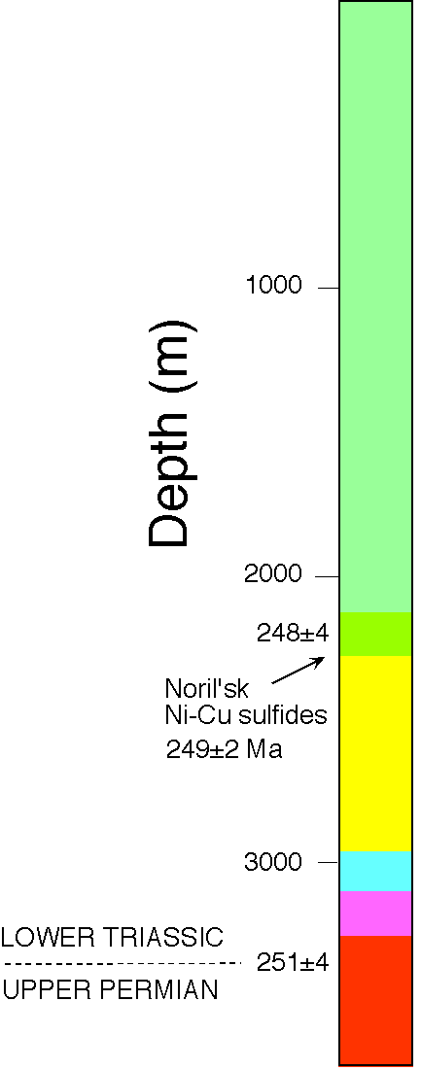
Tackling Some Unanswered Questions
Are associated basalts potentially genetically related?
What do the parental melts of Norilsk look like?
A modelling approach:
Select a range of potential melt candidates
‘Melt’ them, and see what crystallises as they cool
Investigate the potential role of unknown parameters (e.g. H₂O)
Notes:
Now that we’ve looked at a bit of petrography and mineral chemistry, how can we put use this to investigate potential relationships between Norilsk and the associated basaltic suites (above and below the deposit – in green and yellow in this stratigraphic diagram), and potentially gain some insights into what the parental melts looked like
Melt candidates in this case are basalts which have eruption ages close to the age of the deposit
By examining this crystallisation path, we’re checking whether we’re on a similar liquid line of descent
We don’t have a good control on the volatile contents of these magmas, so we can see what effect that might have on the magmas

Slide 3
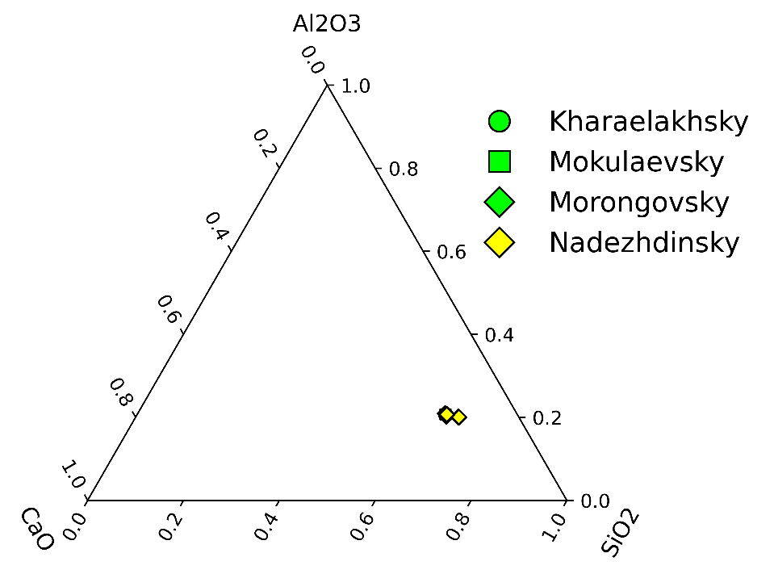
alphaMELTS Models
Command-line based thermodynamic models for melting and crystallisation ‘numerical experiments’
Fast and cheap way to test geological scenarios and hypotheses
Seven compositions from Naldrett (2004) similar in age to Norislk-Talnakh:
Kharaelakhsky (Hr)
Mokulaevsky (Mk)
Morongovsky (Mr1, Mr2)
Nadezhdinsky (Nd1, Nd2, Nd3)
Shallow crystallisation models using MELTS model (500 bar)
Varying H₂O content: Dry, 1 Wt%, LOI (up to 3Wt%)
Notes:
We’ve taken the compositions of a few basalts both stratigraphically above and below the Norilsk deposit, including some from each of the Kharaelakhsky, Mokulaevsky, Morongovsky suites (Green) and three from the Nadezhdinsky suite (yellow)
The major element compositions of all of these are similar
Note that from the beginning we think that the Nadezhdinsky basalts aren’t the best candidates, due to their different rare earth element patterns, but we can check if their major element compositions and phase relationships confirm this suspicion

Slide 4
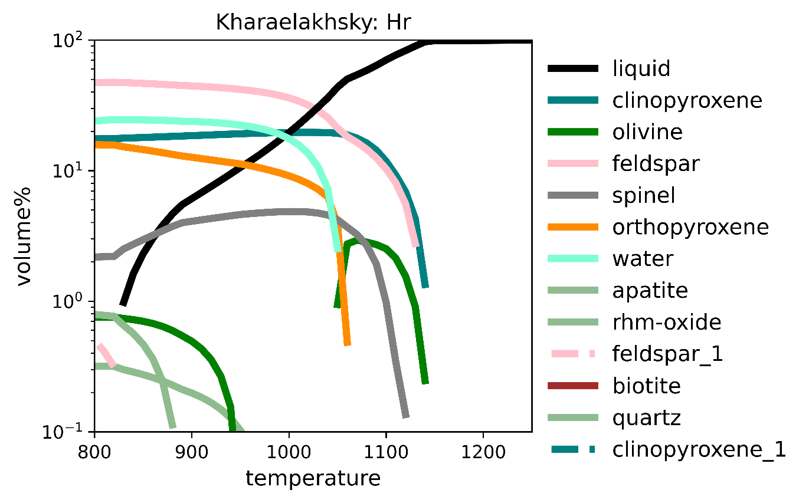
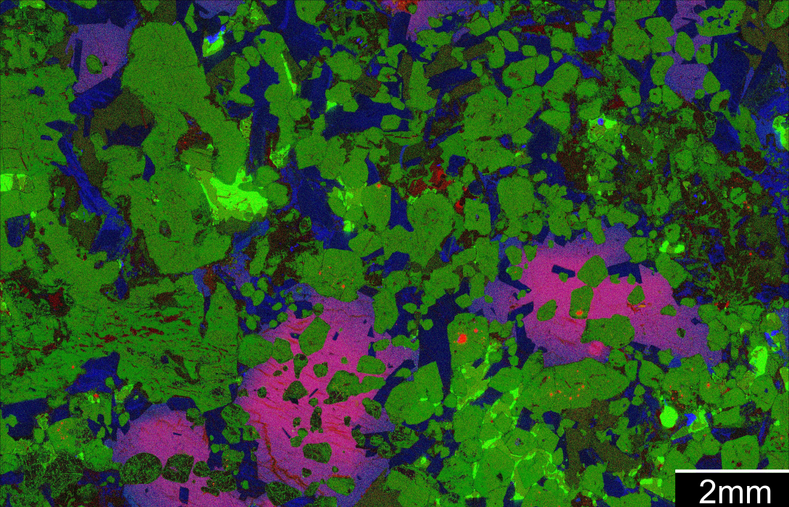

Log
Cr
Log
Ni
Ca
s
PL
OL
CHR
CPX
Notes:
Here I’ve plotted the phase volume relationships during crystallisation of one of our alphaMELTS experiments
Temperature increases along the x axis, so through crystallisation we go from right to left in these diagrams – the black line is the liquid volume, plagioclase is pink, olivine is green and clinopyroxene is a teal colour
Here the later stages of the crystallisation are less relevant – we’re mainly trying to see what the phases near the liquidus are; typically the first 50-80% of crystallisation
We can identify some features of this experiment – the first assemblage on the liquidus is clinopyroxene and plagioclase, which is quickly joined by olivine
These features sound like they could roughly match what we’re looking for, although the phase proportions might be off a bit
Let’s dig a bit deeper

Slide 5
Some Challenges
Models can generate a lot of information
14 files/experiment; 102 for this presentation
Aggregate datasets typically from 10k – 100k rows
How do we pull out models which are most relevant?
Similar crystallisation paths (olivine + clinopyroxene; little orthopyroxene)
Similar mineral chemistry
Rapid clinopyroxene crystallisation
Similar phase proportions
Need objective and automated similarity measures to do this on larger scales
Notes:
We’ve had a quick look at one model, but in this presentation alone I’ve run 102 models (probably a few times over)
It’s easy enough to assess a few models against reality, but when you start to assess many it becomes a bit tricky and typically time consuming
So first we need to define what we’re looking for, so we can pull out models which are relevant
Ideally we should try to make part of this process automated, so we can routinely and quickly pull out interesting or relelvant models

Slide 6
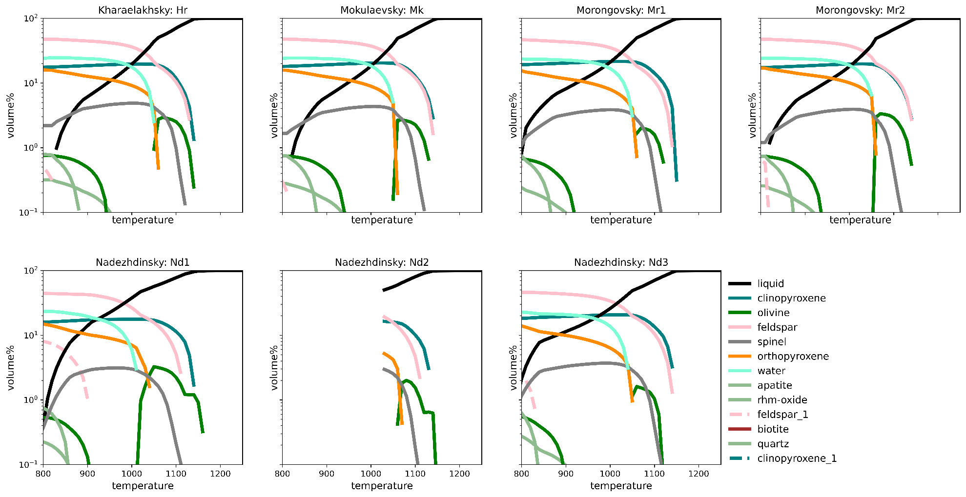
Notes:
Here I’ve plotted up the phase relationships for crystallisation experiments of each of our starting compositions under the same conditions and each with 1 weight percent water
The ‘Green basalts’ are on top, and the Nadezhdinsky ‘yellow’ basalts are below
Overall the compositions show similar crystallisation histories to what we just saw (clinopyroxene + plagioclase, followed by olivine)
The Nadezhdinsky basalts have more variable phase relationships, and the ordering of olivine and plagioclase are typically reversed, but they’re otherwise difficult to rule out here

Slide 7
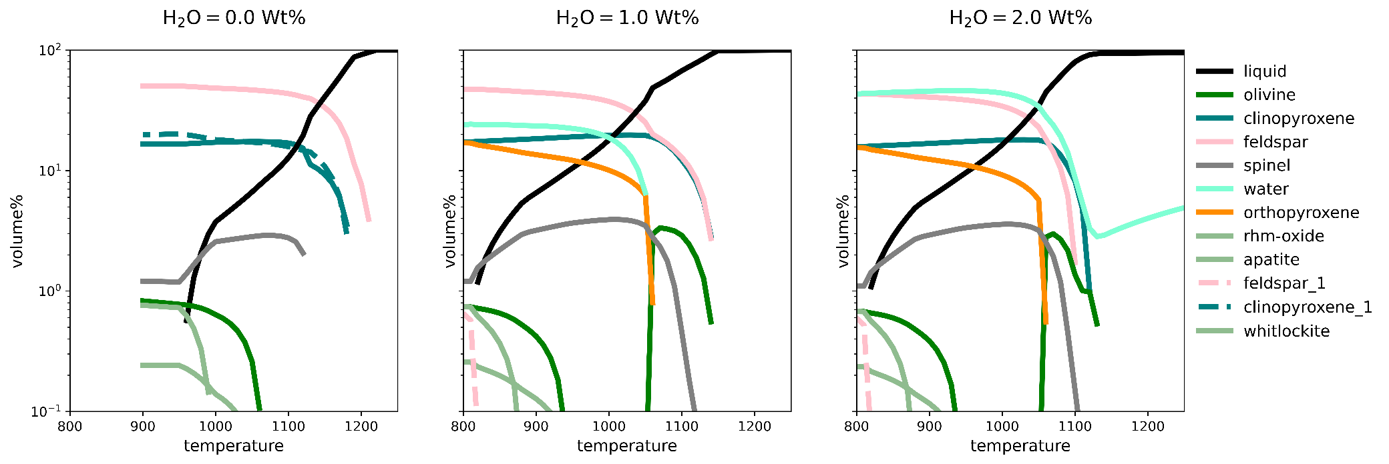
H₂O Content
Notes:
Batch crystallisation of a Morongovsky basalt composition, with increasing about of water – the one on the right assumes all LOI is original water, at about 2%
As you might expect the dry model crystallises more rapidly over a short interval below 1050 degrees where spinel, olivine and orthopyroxene are all crystallising
As we go to the right we end up with water saturated models, and we bring the onsets of olivine, clinopyroxene and plagioclase crystallisation closer together
However, these models also predict that for non-fractional crystallisation at about 1050 orthopyroxene crystallises at the expense of olivine

Slide 8
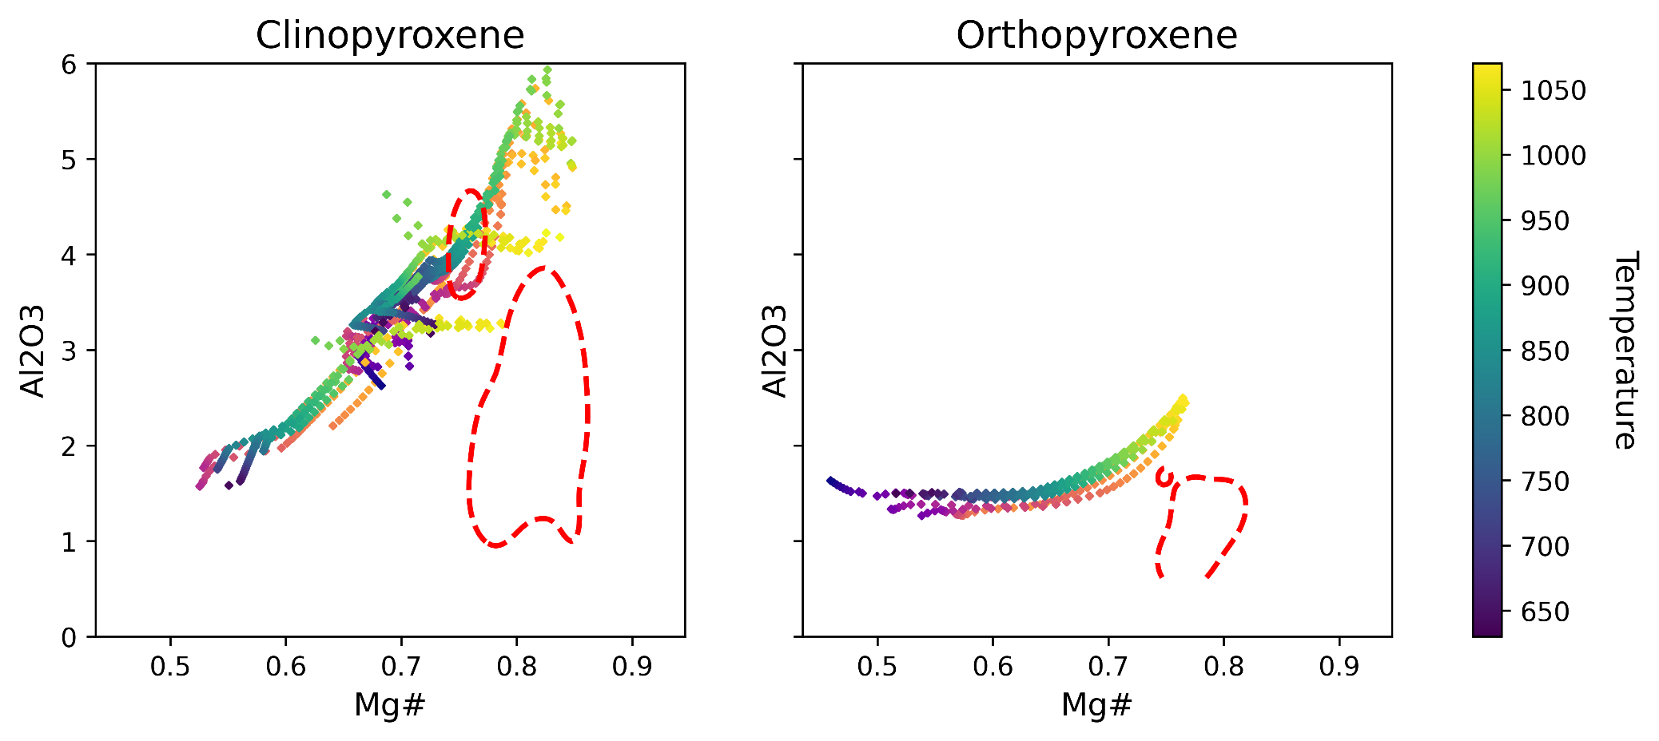
Pyroxenes
Notes:
Here I’ve plotted up compositions for clinopyroxene and orthopyroxene for all of our models, coloured by the temperature at which the phase crystallised
A bit hard to see, but I’ve separated out the green and yellow basalts – green colours for green basalts, and the orangey colours for yellow basalts; they’re relatively similar here
The red contours here represent the 90th percentile data density contour of pyroxene compositions from Norilsk
Mg# on the x axis and aluminium content on the y axis
Pyroxenes in reality have lower Al than predicted, lower Mg numbers

Slide 9
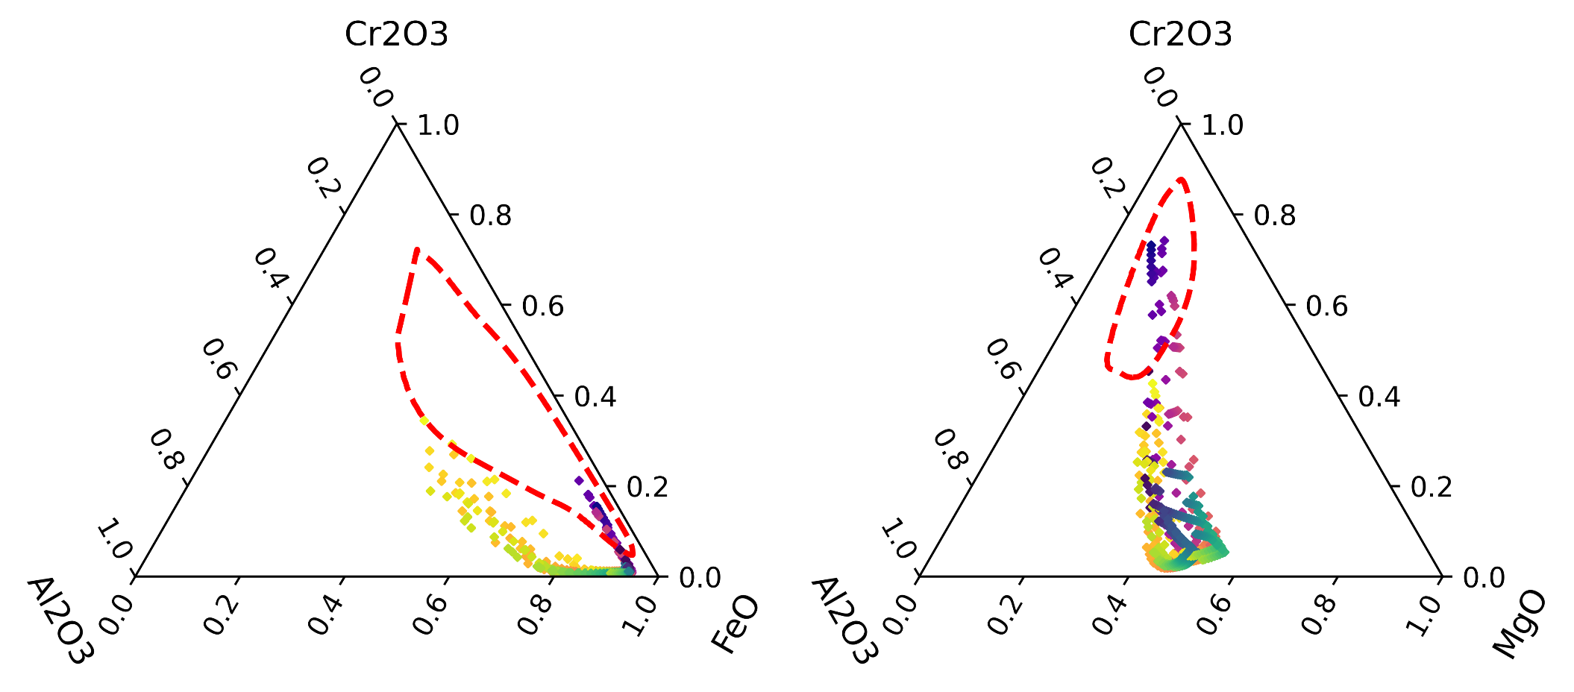
Spinel
Notes:
Spinel compositions from the model are more iron-aluminium rich and chromium poor
Only the lower temperature, late stage spinels from get close to the compositions we find at Norilsk

Slide 10
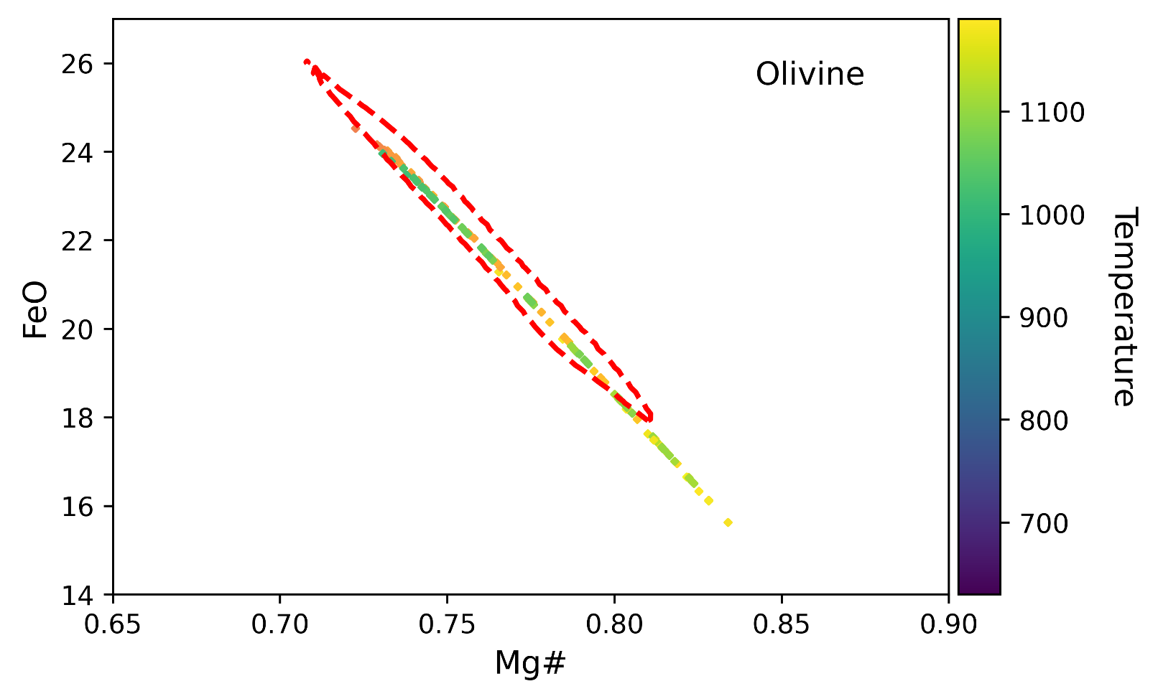
Olivine
Notes:
Zoomed in to show only the higher temperature olivines – ignoring some of the iron and manganese rich late stage olivines
Overall, the olivine magnesium numbers at higher temperatures match relatively well

Slide 11
Commonalities and “Matches”
The compositions largely give the same crystallization histories for the same water content (plag – ol - cpx)
Some general model mis-matches:
Olivine is underestimated, orthopyroxene overestimated
Pyroxene compositions are a bit off (higher Al₂O₃, lower Mg#)
Spinel Cr₂O₃ content underestimated
Are these basalts genetically related to Norislk?
‘Green’ basalts might match more closely, with some H₂O
Can’t rule the Nadezhdinsky ‘yellow’ basalts out with major element and phase proportions alone
Models aren’t too far off, but no hard answers yet – a solid “maybe”
Notes:
The different compositions largely give the same crystallisation sequences
There are a few aspects which are consistently off in our models:
We only end up with a few percent olivine; we end up with a lot of orthopyroxene (these two are related)
Our pyroxene compositions are a bit off when it comes to aluminium content and magnesium number
Our spinels don’t have enough modal chromite component
There might be geological explanations for these, especially given that these basalts may well have crystallised a decent amount of olivine already, and we know that the crystallisation processes during ore deposit formation were largely fractional
So, are these basalts genetically related to Norilsk?
In the end the models aren’t far off, but we don’t have hard answers to

Slide 12
Limitations and Uncertainties
What we put in:
We’ve looked at H₂O, but could also include CO₂
Compositional uncertainty can be important in some cases
Chromite stability may be overestimated slightly (an alphaMELTS issue)
Ore deposit formation is a multi-stage process
Involves fractional processes and assimilation (which we haven’t modelled)
We only see part of the picture with major elements
Integrating trace element data and models might help clarify some aspects
Notes:
We’ve worked with relatively simple models to start with, and necessarily these have some systematic limitations and also uncertainties
What we put in:
There are some potential issues with the accuracy of chromite stability
We’ve looked at the effect of water to a certain extent, but we don’t have a good independent control on this
Compositional uncertainty could influence some of these parameters too
We haven’t quite dug into how exactly the more complex processes associated with ore deposit formation have affected our ability to compare these magmas
Major elements give us some fundamental constraints, but we can incorporate trace element data and models to refine this picture somewhat!

Slide 13
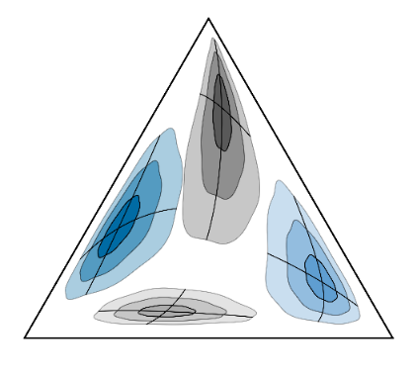
Combining Data with Models for New Perspectives
These are numerical experiments
Simple models are a good place to start, they give us new questions to ask and phase relationships to chase
Best used iteratively as a research tool
To be refined and extended:
More models
Adding olivine back
Trace elements
Automated similarity measures
Find this presentation at: github.com/morganjwilliams/covideo_norilsk_melts
pyrolite
“Python for geochemistry”
pyrolite.readthedocs.io
pyrolite-meltsutil
A limited alphaMELTS wrapper
pyrolite-meltsutil.readthedocs.io
Notes:
These are numerical experiments, and best used iteratively as a research tool
We have some ideas of how to refine our models

Slide 14
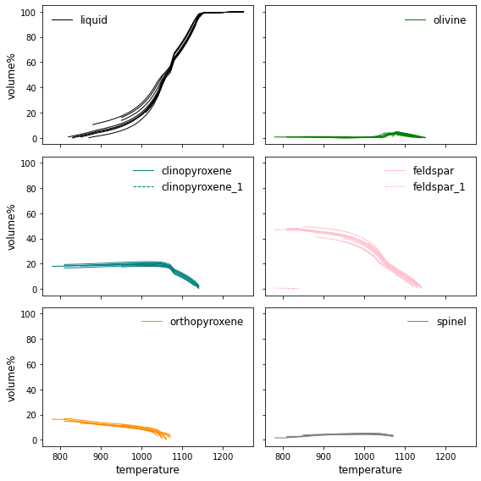
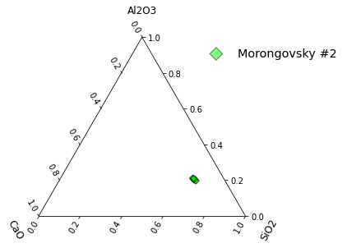
Notes:
Addition of compositional uncertainties to this can be used to understand how this propagates into model outputs, and the significance of some of our metrics
Typically modulates mineral proportions and exact timing of crystallization but less so the sequence

